Slide 1




Study, development and deployment of a BI decision-making dashboard for an online store
End of Study Project
Realized by: Zayneb Hmida
Supervised by: Mr. Ahmed Ghazi Blaiech
Mr. Sabeur Rannen
2019/2020
Notes:
Good morning/Afternoon Ladies and Gentlemen, MR *** , mrs **** I am Zeyneb hmida, As nervous as I am standing here today I am also proud to be sharing my experience with you all . First of all I would like to thank you all for being here to evaluate my graduation internship project. Before starting , I really appreciate your attendance, and I want to deeply thank my mentor Mr. Ahmed Ghazi Blaiech for his massive support and mentoring throughout this project. Thank you sir ( oghzerlou w 9oulhelou ) Well, This project was done in order to obtain the national engineering diploma in computer science. The Topic of the project revolves around the Study development and deployment of a BI decision-making dashboard for an online store It was performed at Cloud Temple Tunisia for its client Kamidocity. The project was academically supervised by Mr. Ahmed Ghazi Blaiech. And professionally by Mr. Sabeur Rannen.
I really appreciate your attendance, and I want to thank deeply my mentor Mr. Ahmed Ghazi Blaiech for his massive support and mentoring throughout this project.
The Topic of the project is the Study development and deployment of a BI decision-making dashboard for an online store
It was performed at Cloud Temple Tunisia for its client Kamidocity.
The project was academically supervised by Mr. Ahmed Ghazi Blaiech.
And professionally by Mr. Sabeur Rannen.

Slide 2
“Data will talk to you if you are willing to listen .”
Jim Bergeson
Notes:
Since our project is a BI project,It is purely based on data,
Using data correctly is crucial for any business in order to find success. Take time to look into the best practices for any company and achieve a long-term goals.
So , as Mr Bergeson said:”,,,,,,”

Slide 3
Plan
1
General Introduction
2
Project Context and Overview
3
Analysis and requirements specification
4
Technical Environment
5
Data integration
6
Data Restitution
7
Finalization of the decision-making system
8
Conclusion and perspectives.
Notes:
Here is the plan that I’m going to follow in order to present my project,
1*I’m going to start with a little introduction giving you an overview about the project circonstences
2*Then, I will present the general context while putting the light on the major problem and the existing solutions and their limits,
3*After presenting the proposed solution,I will enumerate both functionnal and non-functionnal requirements of this project,
4*Passing to the technical environment and all the tools used in it,
5*Setting up all the requirement, We will start the creation by the data integration
6* Then the data restitution which will be obvious and clear in my little demo of the final dashboard
7*Going next to the Finalization of the decision-making system
8*And finally ending this presentation with a perspective on the possible yet unused ideas to enlarge this project

Slide 4
1.
General Introduction
Hosting company overview
Notes:
First, Here is our project overview:

Slide 5
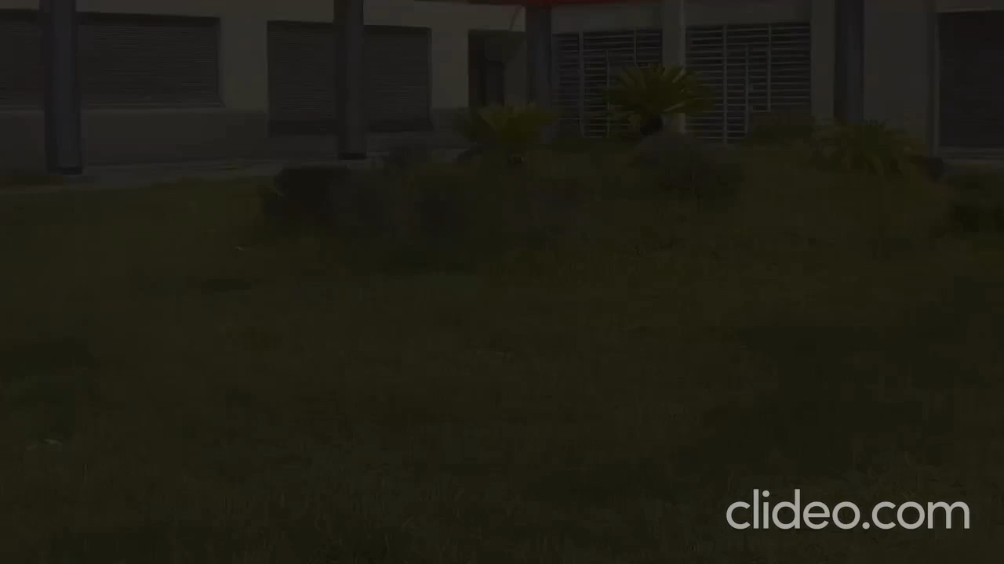
Notes:
As part of my project, I did my internship with Cloud Temple Tunisia, which entrusted me with the design and production of a Dashboard for their "SoCharme" store.
Cloud Temple serves organizations that need to dispose of conventional IT and repeating blackouts of their basic servers to exploit the advantages of the private and open cloud.
They provide services such as: Virtual Datacenter ,Housing , Collaborative messaging, Outsourcing, PRA and many others

Slide 6
Maps
Paris
Caen
Lyon
Nantes
Tunisia
Abidjan
Notes:
They are located in many cities all across the world, basically in France in Paris, Caen, Lyon, Nantes
Also in the Ivory Coast ,precisely in Abidjon
Last but never least ,it is located in Tunisia ,in the capital in particular

Slide 7
2.
Project Context and Overview
Project context and Analysis of the existing solutions
Notes:
Moving on to the Project’s context now,

Slide 8
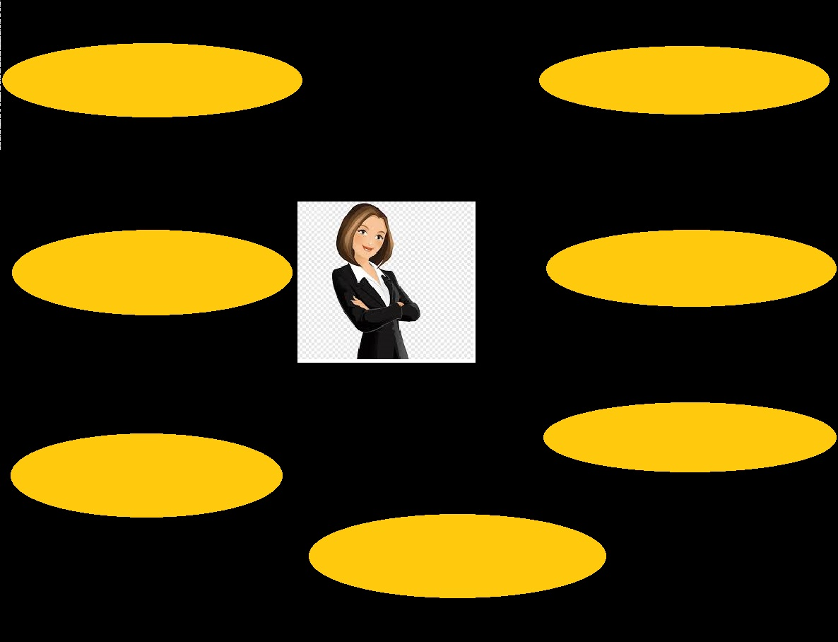
Store Monitoring
Supervise the current state of the store
Take Advantage of Email Marketing
?
?
Provide Popular Payment Options
?
Encourage Social Sharing
?
?
?
?
?
Build Buyer Trust with Product Reviews
Advertise on Social Media
Track Analytics and Iterate
8
Notes:
I would like to start with explaining the role of an online store owner which is basicly to monitor the store,
By monitoring i mean:
-Supervise ,,,,
-Provide,,,,
-
-
-
-

Slide 9
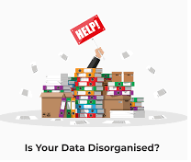



Problems with disorganised Data
Notes:
One of the major problems that can face any store owner is « disorganized data »
This major trouble can lead to:
Unpreparedness when disaster strikes: Unorganized data has a negative effect on disaster recovery. Without a clear picture of the data a business possesses, it is impractical that it would create a disaster
Wasted time: Retrieving unstructured data is always a nightmare. The process is frustrating and takes a lot of time.
Things fall apart: a business that has not figured out how to organize its data can find itself with so much unorganized data that is almost impossible to fix.

Slide 10
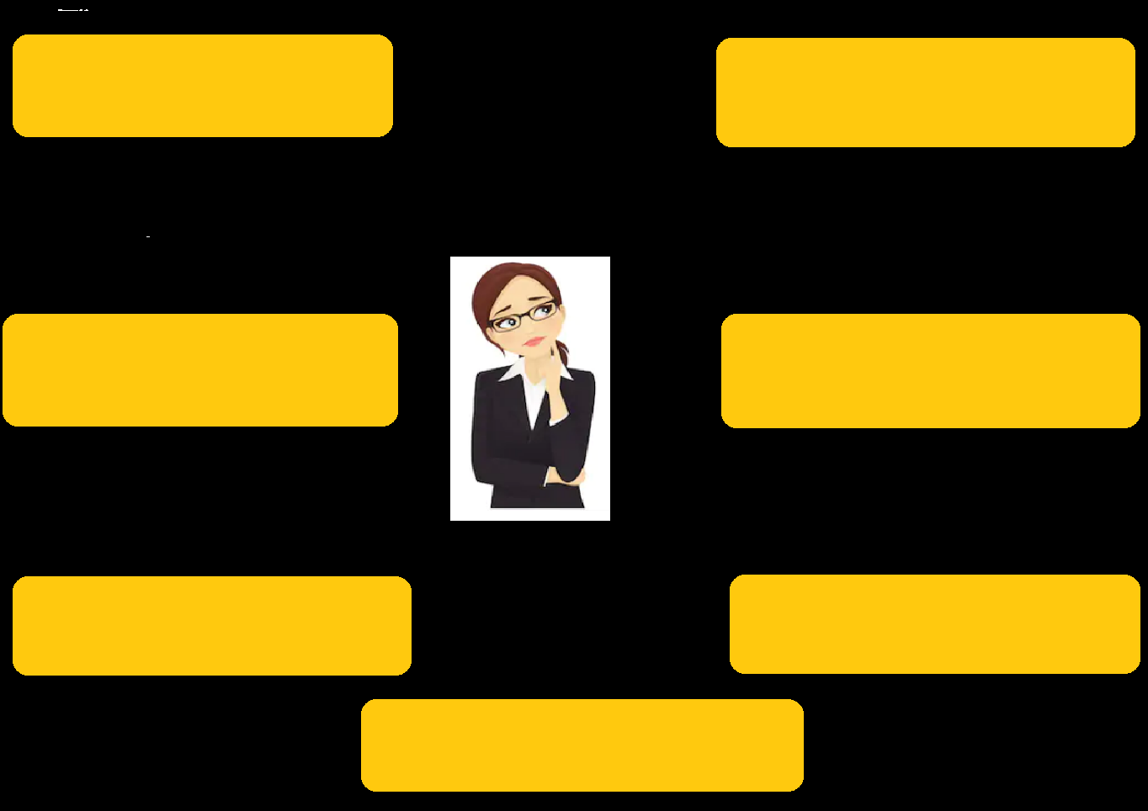
Big concept
Add new product or delete an existing one?
Create another store or improve the current one?
What decision should I make???
?
?
More or less Ads?
Hire more employees or fire some?
?
?
?
Bring the attention of your audience over a key concept using icons or illustrations
Stop this campaign or launch another one?
?
Enlarge my storage or keep them that way?
Change my suppliers or stick with them?
10
Notes:
When data is unstructured and randamly put into action,this will effect the decision making part
Because the major questions such as (from the diap) will remain unanswered

Slide 11
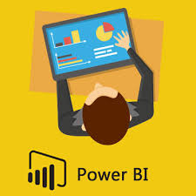
Purpose!
Ability to make the RIGHT decision at the RIGHT time
Reveal the problems and fix some of them
Ability to track the previous, the current and future state of the store
Compare the existing with the “supposed to be”
Understand the relations between used platforms
ACCESS TO more information about transactions
Notes:
That is why our main objectif and purpose is basicly to create a BI dashboard that give us the:
-(diap)
-(diap)
-(diap)
-(diap)

Slide 12
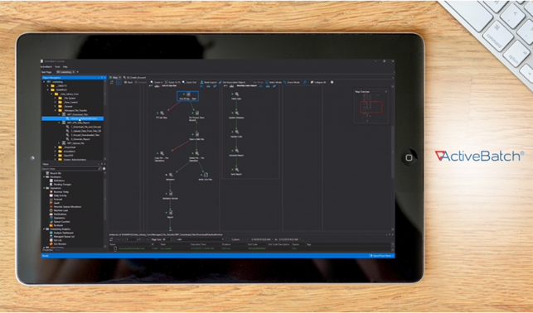
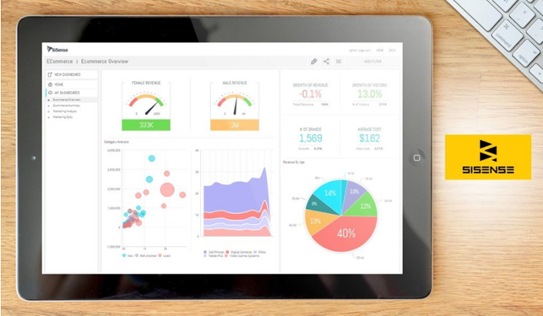
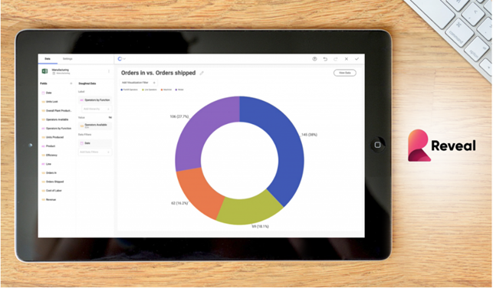
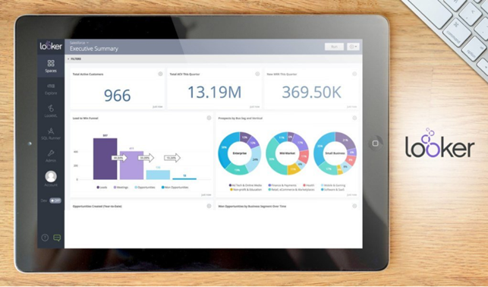


Existing Solutions
Active Batch
Sisense
Reveal
Looker
UI.
Easy to manipulate.
Multiple Visualization.
Decision
Making tools
Notes:
In order to create this Dashboard there are several tools and solutions such as : Active Batch, Sisence,,,
When it comes to the user interface,there have been some complains in sisence and reveal that led to problems in manipulations
And one of the most important caracteristic in BI ,charts ,
And obviously, both Active Batch and Looker are short on them
Finally , the presence of a decision making tool is crucial
That’s why choosing to work with active batch is out of the equation

Slide 13
Why Power BI???
Easy to manipulate.
Multiple Visualization.
Decision
Making tools
UI.
Free
Live Streaming
Data Integration
Data search
Notes:
So,choosing Power BI is due to the interface which is a user-friendly and that has been conceived for the use of a maximum of people. Also, it is known for the large number of visualisations offered to make your report excellent and distinctif. Finally, it contains both Python and R language compilers to make your job of decision making much easier.
Also Power bi is free and available ,it provides a very good data seach ability ,it offers th oppurtunity of live streaming and has a large data integration possibilies
All of those options will Make the job much easier even to someone who is beginning to learn BI

Slide 14





Proposed solution
Notes:
Also ,the proposed solution should be able to collect data from FBM, Recharge and shopify and unify it by creating the links through commun data,
And eventually create a BI dashboard that responds to the features previously mentionned

Slide 15
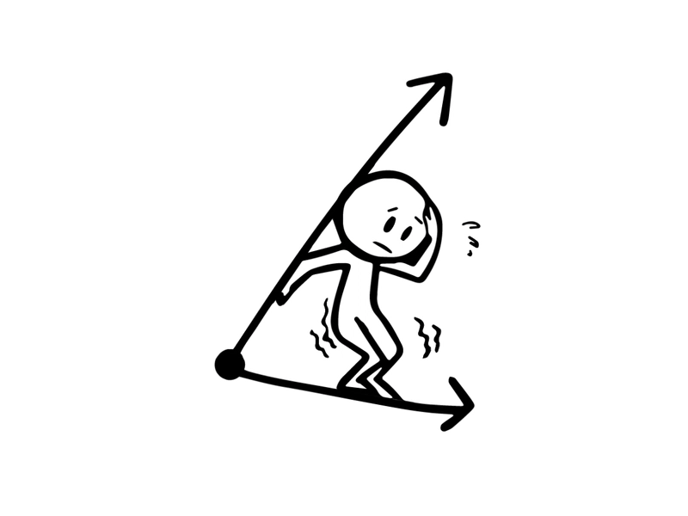

Methodology!
V1
Vn
Notes:
While creating this project,the choice land on the Agile methodology for obvious reasons such as:
The time factor which is very important ,we need to deliver our project at a precise time that we will be able to predict from the bigenning,
The Second is that we work with versions ,we start with a version and sometimes we end with another version that has nothing to do with the first one
Finally, our client is included all long of the project and we check with him after any change we make ,

Slide 16
Agile Methodology benefits
Improved Quality
Transparency
Agile
Early and Predictable Delivery
Predictable Costs and Schedule
Allows for Change
Notes:
These are some benefits of using Agile:
-(diapo)
-(diapo)
-(diapo)
-(diapo)
-(diapo)

Slide 17
3.
Requirements specification
Functional and non-functional requirements.

Slide 18
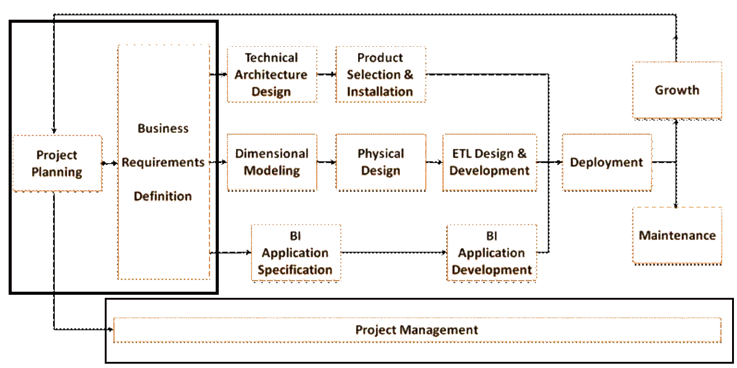
Ralph Kimball methodology
Notes:
When it comes to data warehouse designing, two of the most widely discussed approaches are the Inmon method and Kimball method. For years, people have debated over which one is better and more effective for businesses. However, there’s still no definite answer as both methods have their benefits and drawbacks.
I have chosen the most recent one which is Ralph Kimball
And here is the architecture(diap)
While doing the project management with the agile methodology, we will take these phases one by one, And currently we are working on the project planning and the business requirements definition,

Slide 19


Key Actors
1
2
The decision maker
The administrator
Notes:
In our solution, the end user varies according to the context which depends on the organization chart of the company,
We can then merge all these types of actor into one actor.But we can majorly have two basic actors who are:
Administrator: He is the one responsible of the monitoring and the update of the several reports of the Dashboard.
Decision maker: His role is to consult the dashboard and according to the results, he must take the decisions for the store.

Slide 20
Functional requirements
The decision maker
Take decisions based on the existing
Supervise the store
Do a “What IF” analysis
Notes:
Here are the Functional requirements divided by the actor in question,
The decision maker needs to:
-(diap)
-(diap)
-(diap)

Slide 21
Functional requirements
The Administrator
Data integration
Subscription tracking
Deposit tracking
Creation of dashboards
Turnover tracking
Product tracking
Maintenance of the Dashboard
Ads tracking
Monitoring the effectiveness
Notes:
As for the administrator, he search the ability of:
-data integration
-maintenance of the dashboard
-creation of the dash which includes(diap)

Slide 22
Non-Functional requirements
Interface ergonomics
Ease of use
Response time and optimization
Reliability
Flexibility
Notes:
Here are the Non-Functional requirements that our dash should respect:
-(diap)
-(diap)
-(diap)
-(diap)

Slide 23
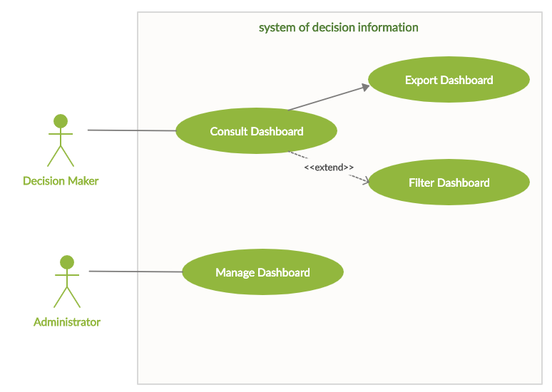
Our use-case diagram
Notes:
Indeed, the figure presents the main use cases of our system as well as the possible actors.

Slide 24
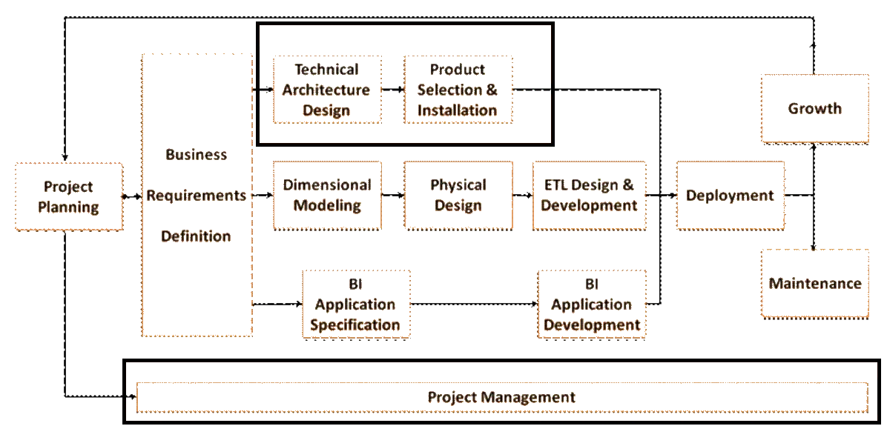
4.
Technical environment
Notes:
After finishing the first phase of the Ralph Kimball architecture, we can pass to the second one which includes
Preparing the technical arch design and the selection of the products to install

Slide 25

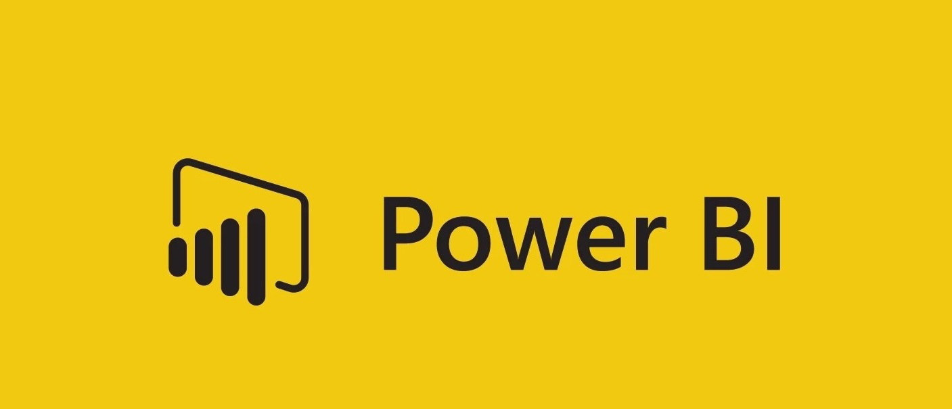


Technical environment
Notes:
Which are obviously ,power bi premium for the dash creation and data manipulation
Dropbox for project sharing with the client
And creately to create the diagrams we are going to follow

Slide 26
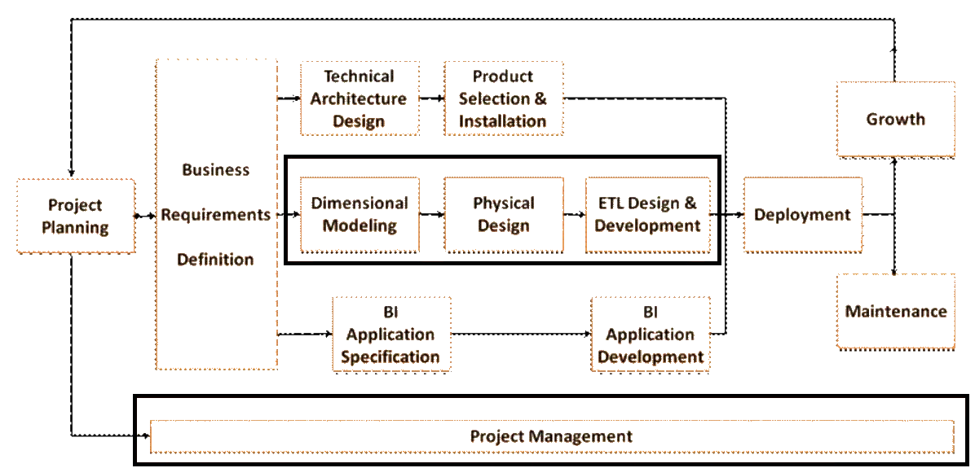
5.
Data integration
Notes:
Now we shall pass to next phase of dimensionnal modeling which requires in first place the ability to know what kind of data we are dealling with,

Slide 27
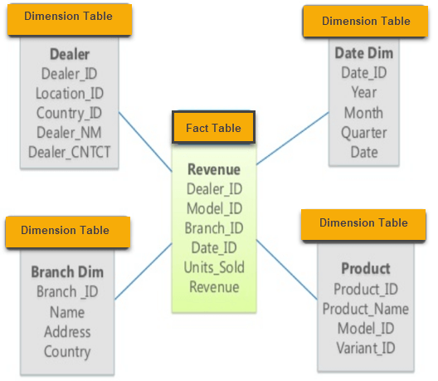
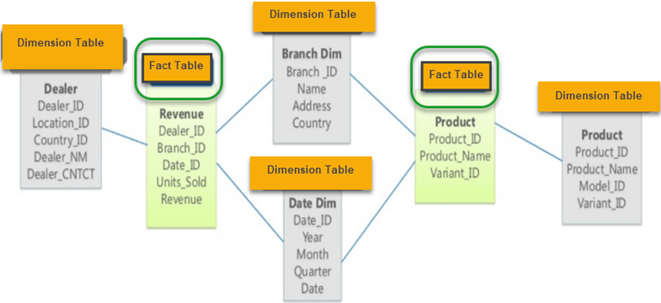
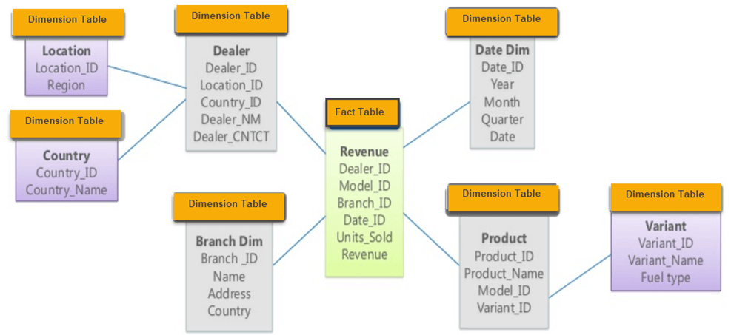
Data storage
Snowflake
Star
Galaxy
Notes:
Well,data storage can take 3 potential schemas:
-the first one is the star schema which is known by his unique fact table and by fact table we mean a table that had been touched for a certain purpose such as adding a new collumn or mesure,the rest of the tables should be dimentional which means intact,
- The second type is Snowflake which is based on the first type but more sufisticated and has more dimentional tables attached to the previous ones,
-At last,we find the galaxy schema which is based on more than one fact table

Slide 28
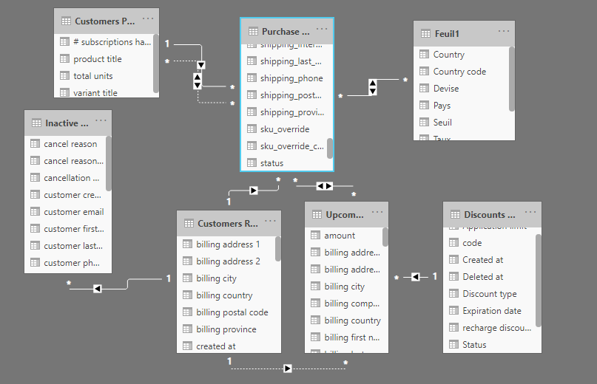
Our data
Notes:
In our case, we have two fact tables named « customers report » and « Purchased Items »
So we basicly have a galaxy schema,

Slide 29
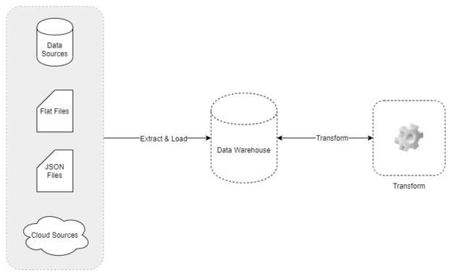
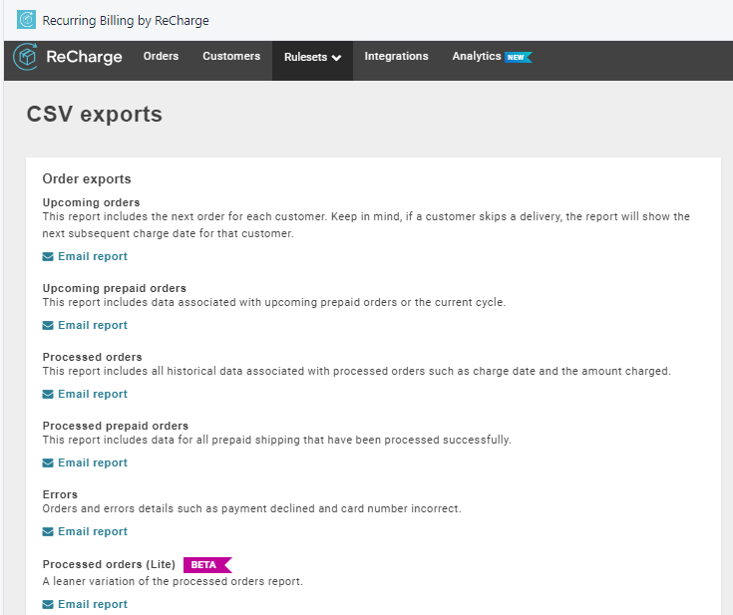
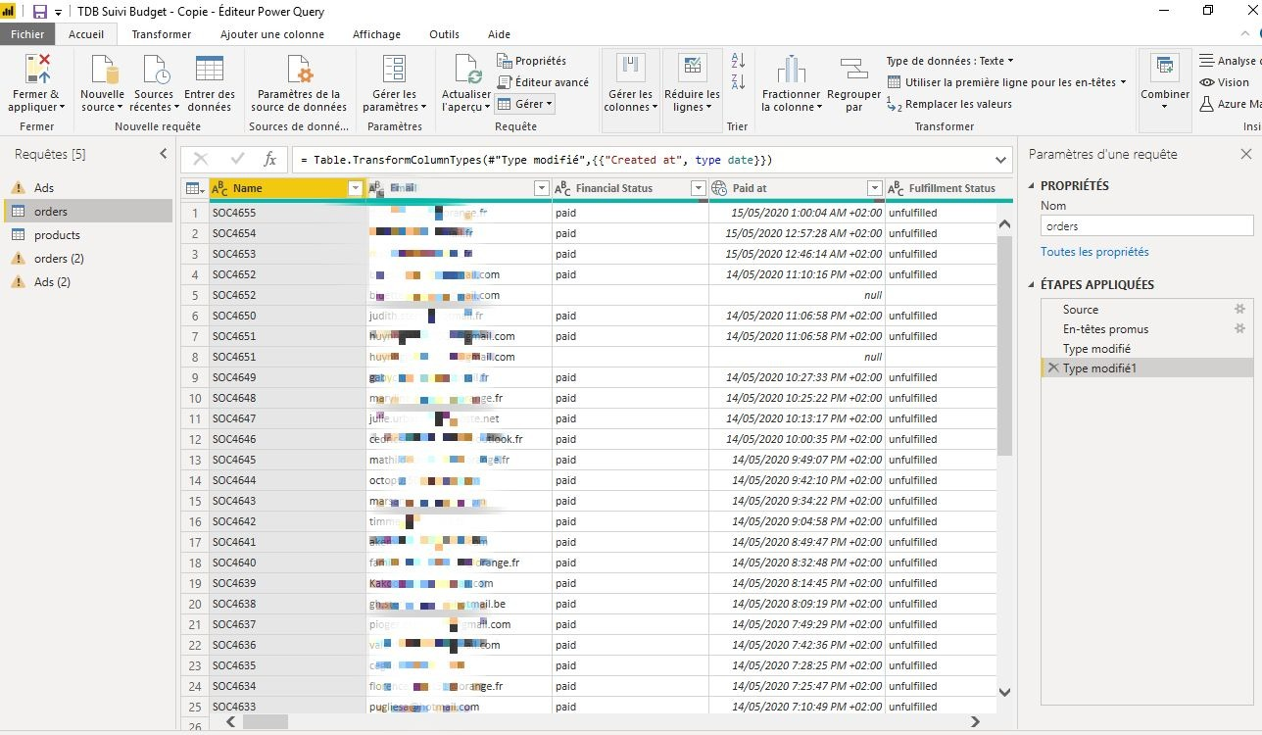
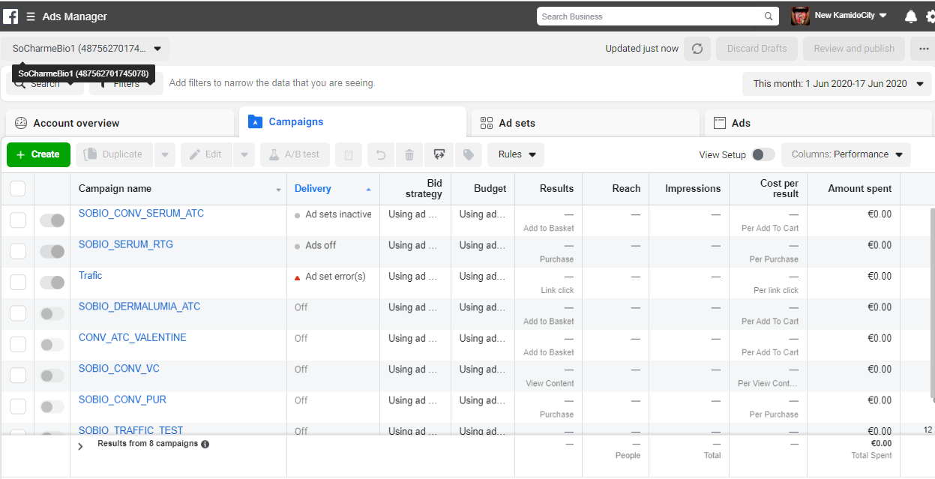
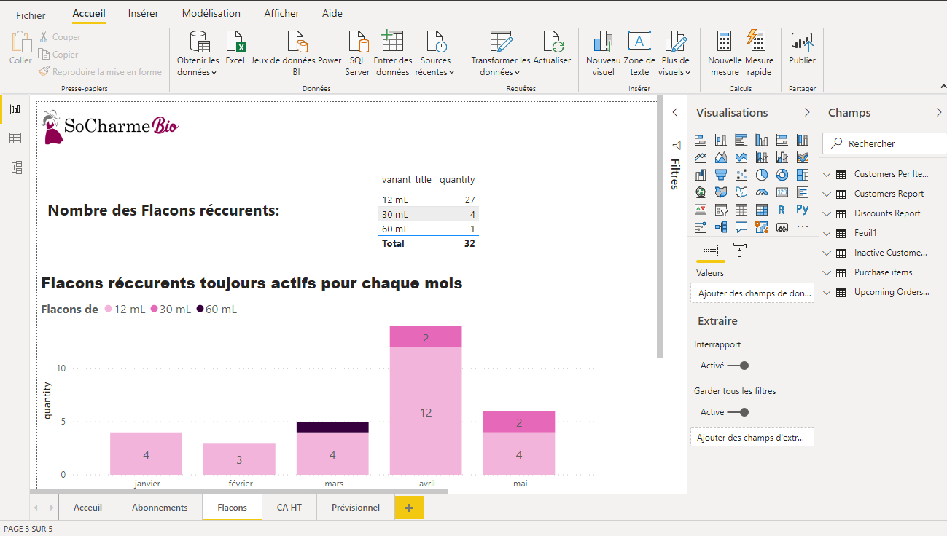
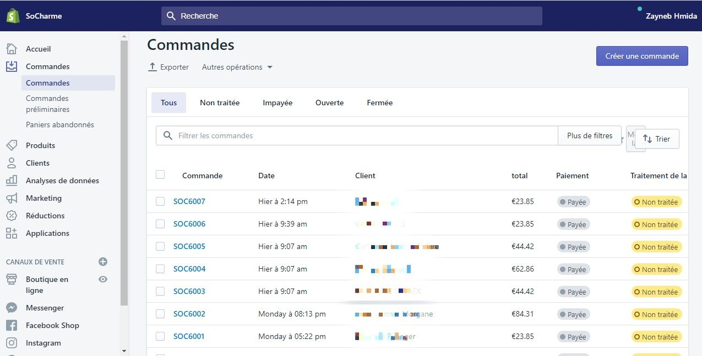
ETL
Notes:
Now , we find our self faced with one of the most important and crucial phases of any bi project,
Which is the ETL phase ,By ETL ,we mean extract,transform and load
As for he extraction,we are going to retrieve date from Shopify ,recharge billing and FBM
Once successfully extracted,data is now safe in our Querry editor that give us the chance to transform it according to our need
Finally, our data is loaded into power bi and now is ready to use,

Slide 30
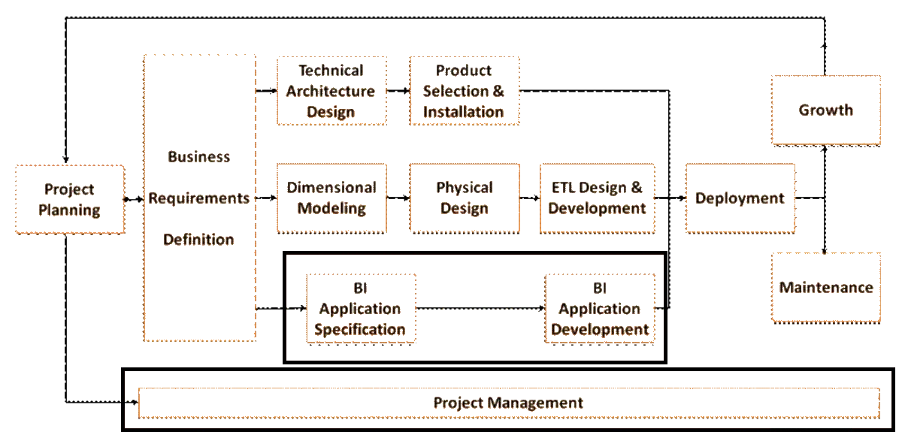
6.
Data Restitution
Notes:
Next phase in our Ralph Kimball architecture, is The specification of the app and her developpement

Slide 31
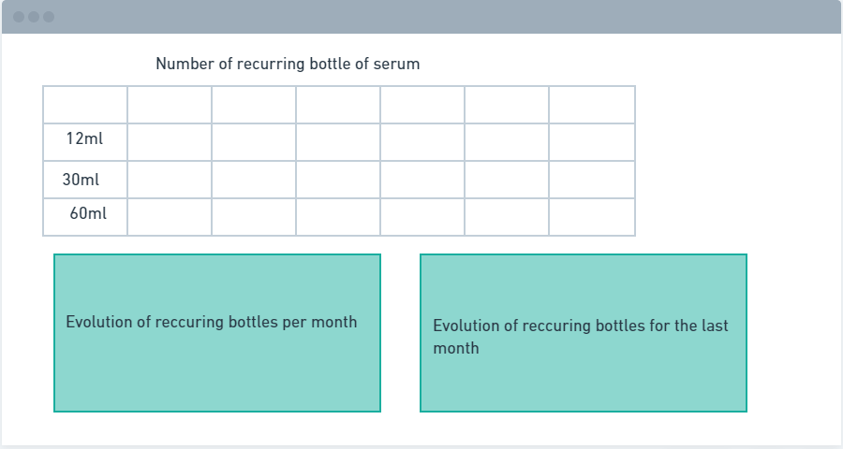
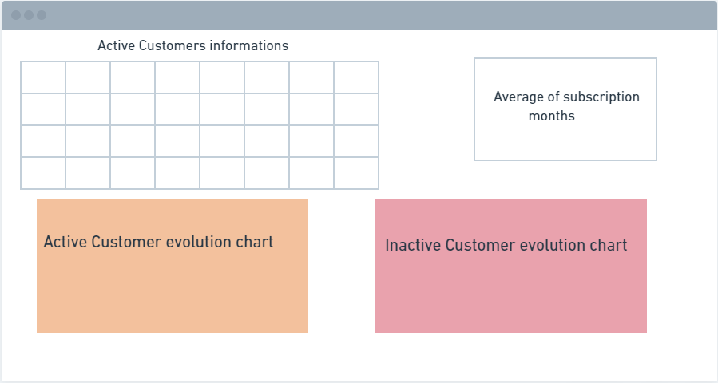
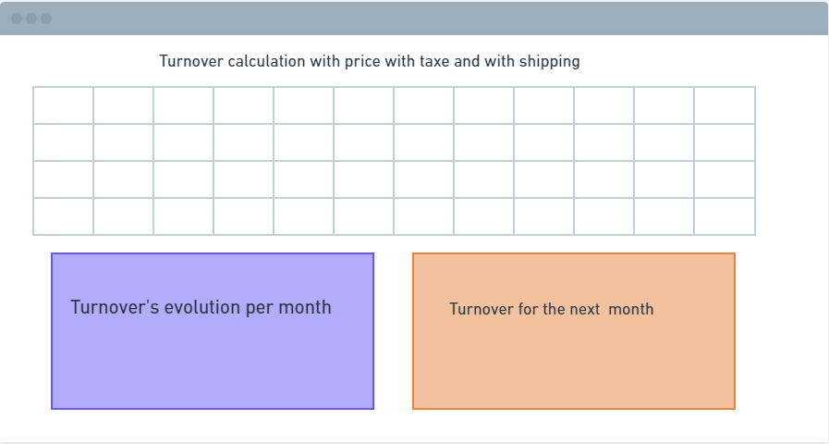
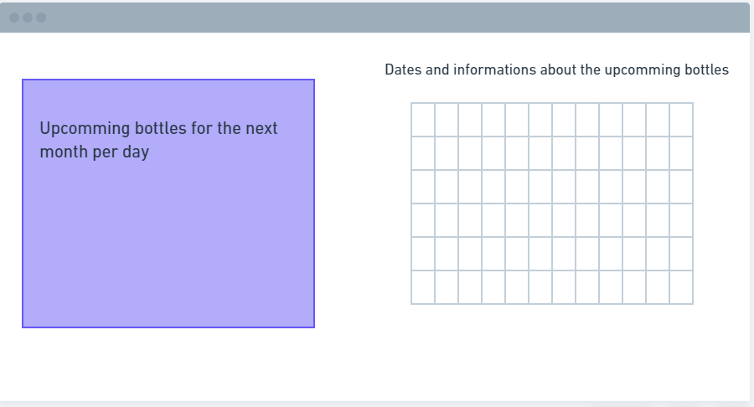
Application Specification
Notes:
That’s why,I took my time and i created some sketches according to the client specifications and I reviewed them with him befaure starting the developpement phase,
Here are some of these sketches:
-(diapo)
-(diapo)
-(diapo)
-(diapo)

Slide 32
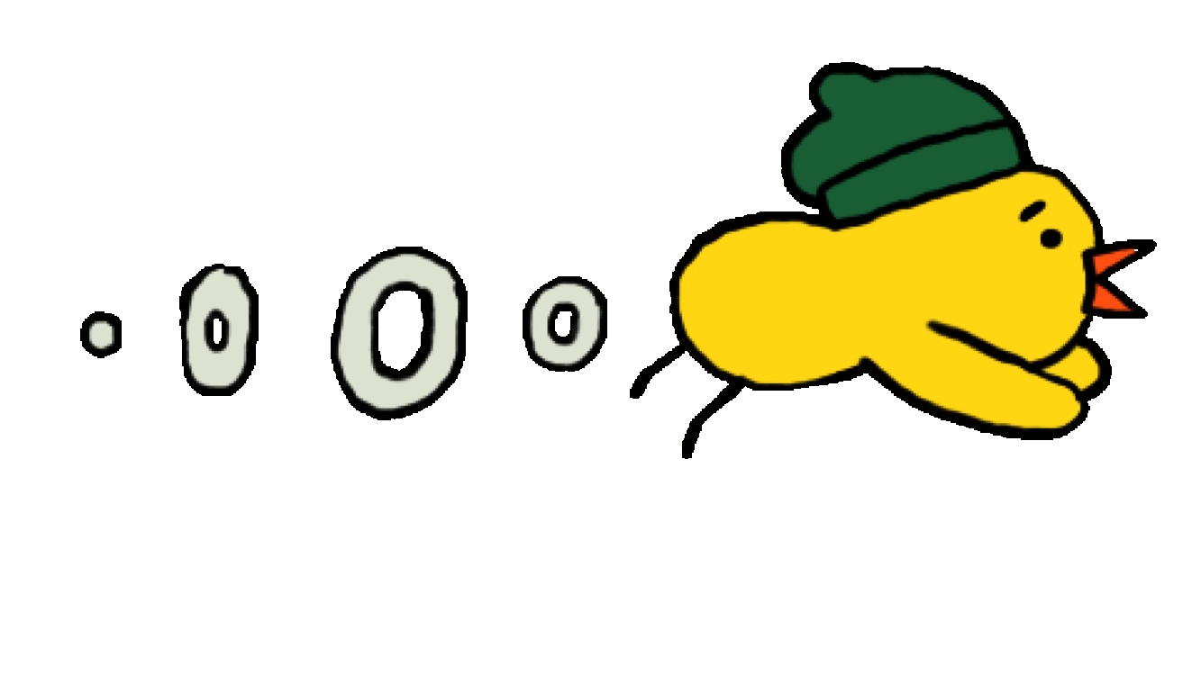
Let’s go!
Demo!
Notes:
Now that we come all across these phases, we are ready to take a look at our final dashboard
(demo)

Slide 33
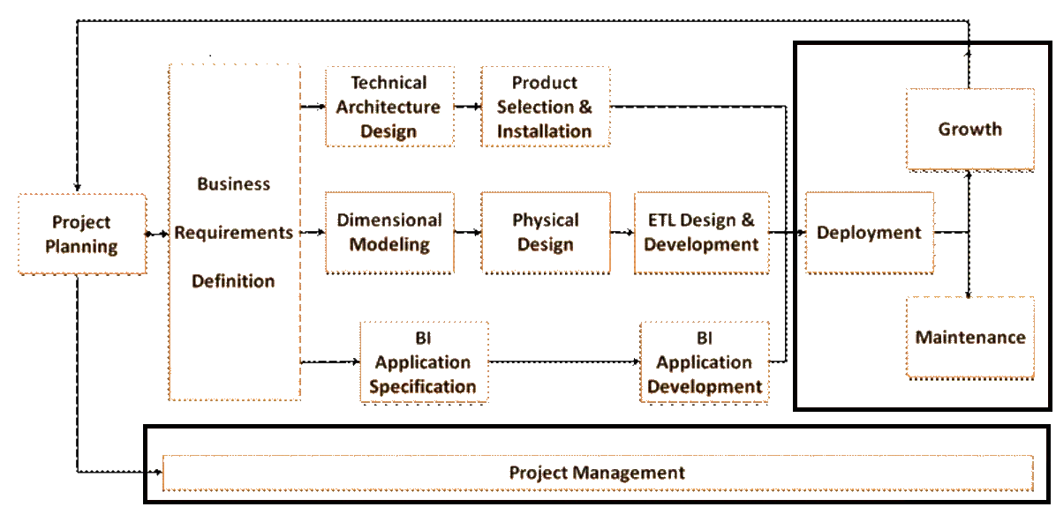
7.
Finalization of the decision-making system
Notes:
The very last phase of our RK architecture ,is the developpment which was put into light throug the previous sheet of predictions that I was explaining
As for the maintenance, after creating multiple dashs at first, we took the decision to merge them into one,which was also previously shown
At Last, for the growth part, we could have optimized our solution at different architectural layers. Layers include:
-The data source(s)
-Visualizations, including dashboards, Power BI reports, and Power BI paginated reports
-The environment, including capacities, data gateways, and the network

Slide 34
8.
Conclusion and perspectives
Notes:
Finally ,we come to the end of this presentation

Slide 35

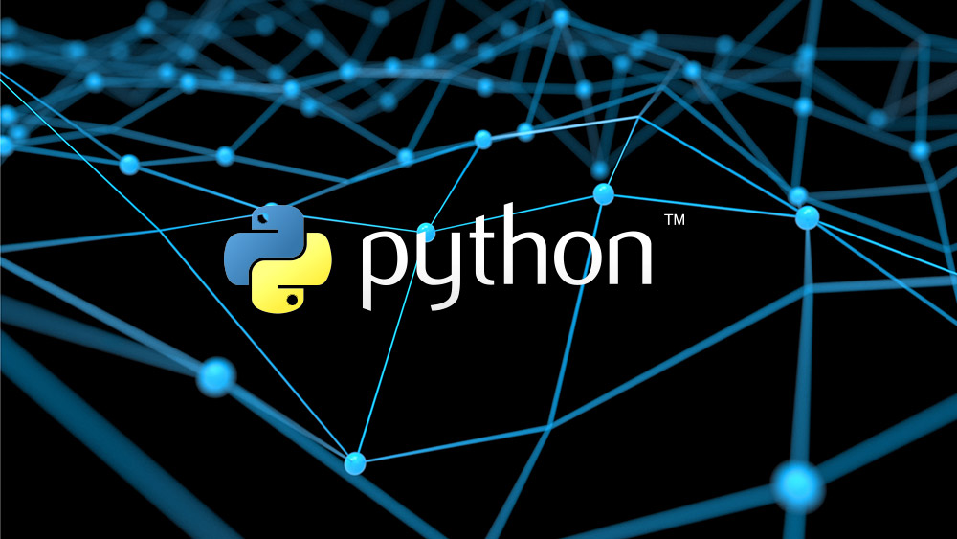
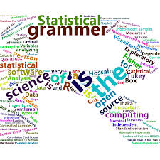
Predictions:
Notes:
As a perspective, our solution has the advantage of being open and extensible, in this context that we plan to extend our project by adding new axes to be treated according to the customer's need. Also, there is a possibility for a precise prediction through the python or R language tools in power BI.With the right algorithm and Dataset, we are able to predict ‘unknowns’ once it learns from the ‘known’ values,

Slide 36

Thanks!
Any questions?

